Slide 1
Morse Code Translator
Jacob Perry, Jessica Ramirez, Lola Shadare

Slide 2
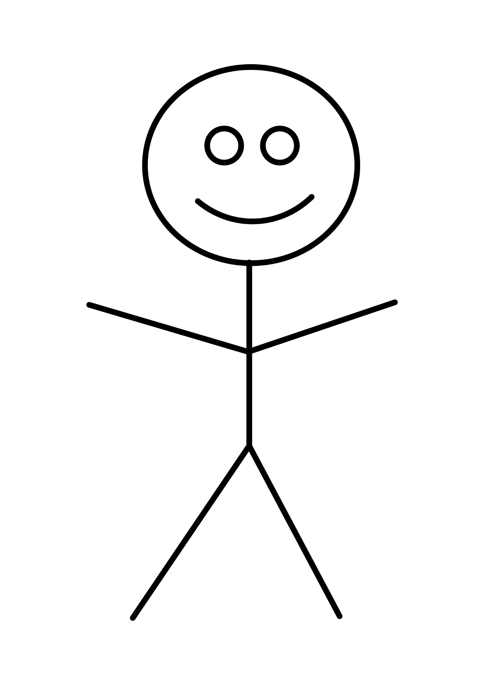
Our Goal
Our goal of this project was to receive a message in morse code through button presses and display the decoded message on a screen.
…. . ._.. ._.. ___
Hello!

Slide 3
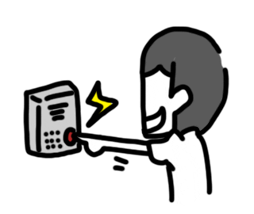
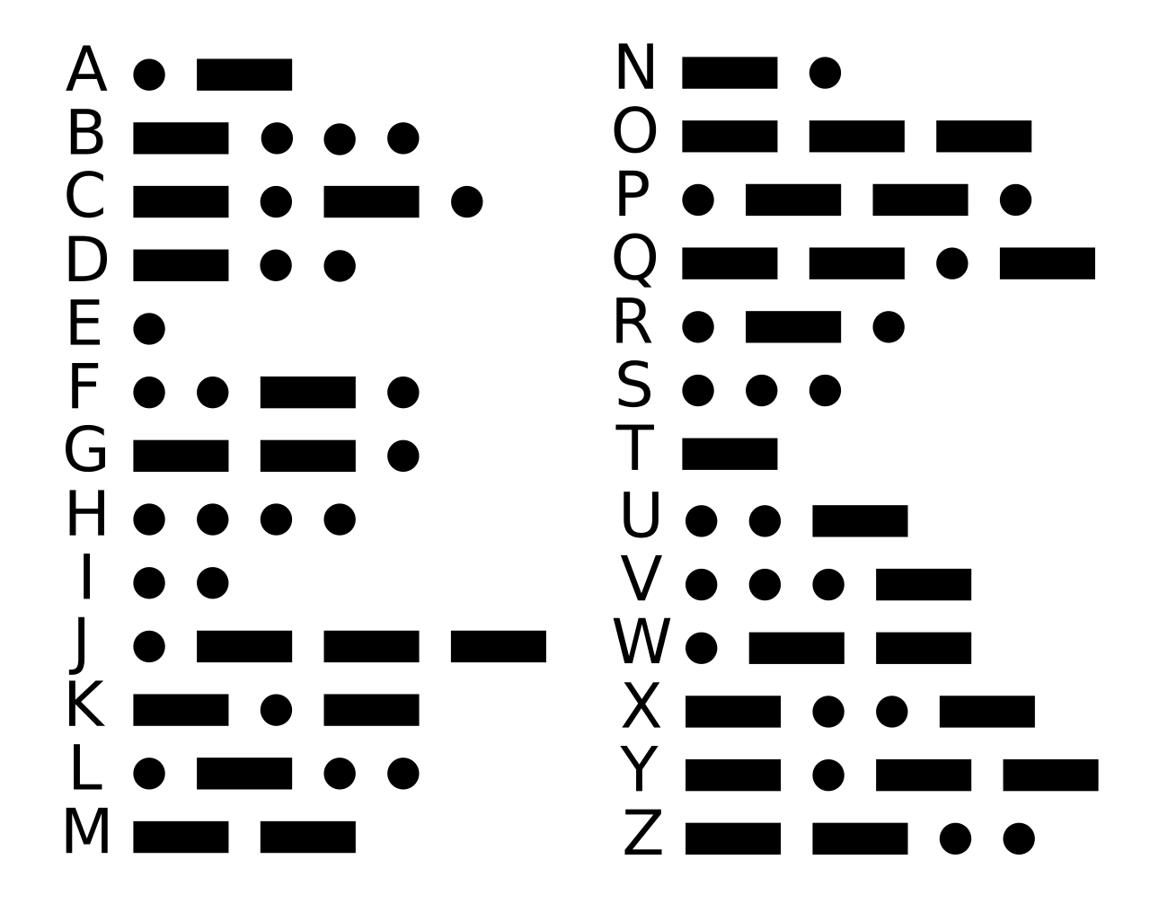


Enter your morse code message into the FPGA board
2. Decode the morse code input
DECODED
MESSAGE
3. Display the decoded message on the VGA.

Slide 4
Translator Details
Encoder
Decoder
Get the button input and identify each letter in morse code.
Assign each letter with its corresponding letter in the alphabet.
Display
Using the VGA, display the inputted message fully translated.

Slide 5
Block Diagram
vga_controller
clk
hsync
clk
clk_div
reset
vsync
video_on
x
y
button_encoder
decoder
ascii_rom
clk
clk
clk
[4:0]
letterNum
[4:0]
button
[7:0]
[7:0]
[4:0]
[4:0]
row
[3:0]
send
[7:0]
data
char_generator
vga_green
VGA

Slide 6
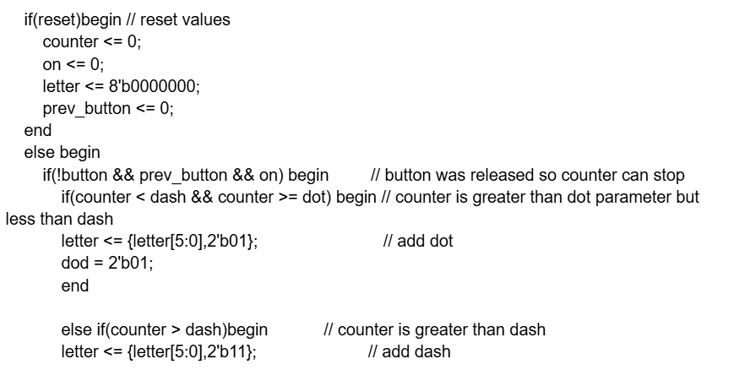
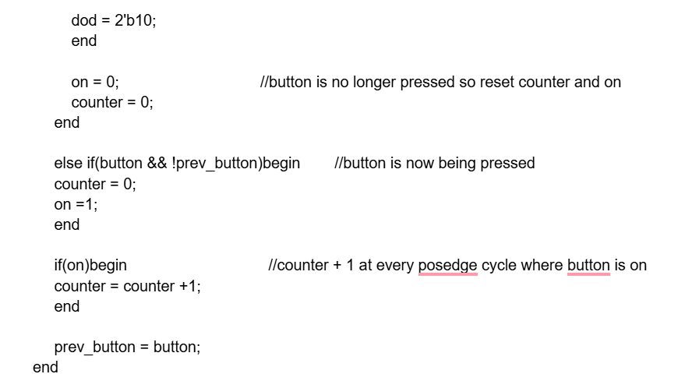
Encoder Code Snippet

Slide 7
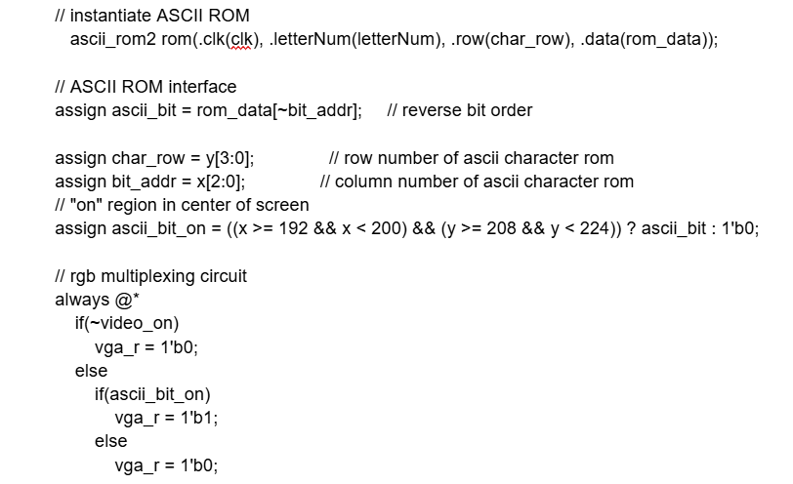
Display Code Snippet

Slide 8

Successes & Failures
Receives a series of dot and dash inputs based on the duration of button presses
Displays decoded letter on screen (works for all 26 letters)
Display more than one letter at a time
Decoding process is slow

